Slide 1
Newton’s Method for Optimization
Caleb Maddry

Slide 2
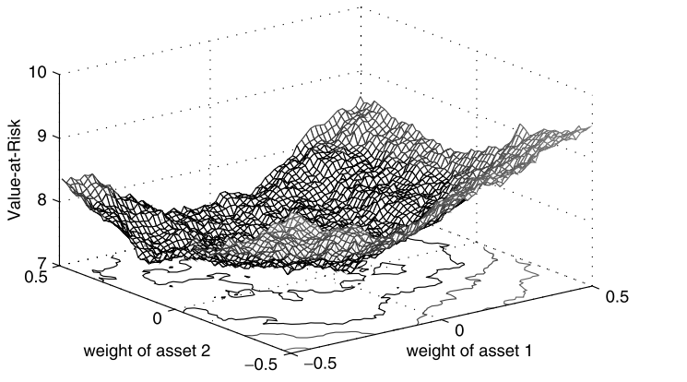
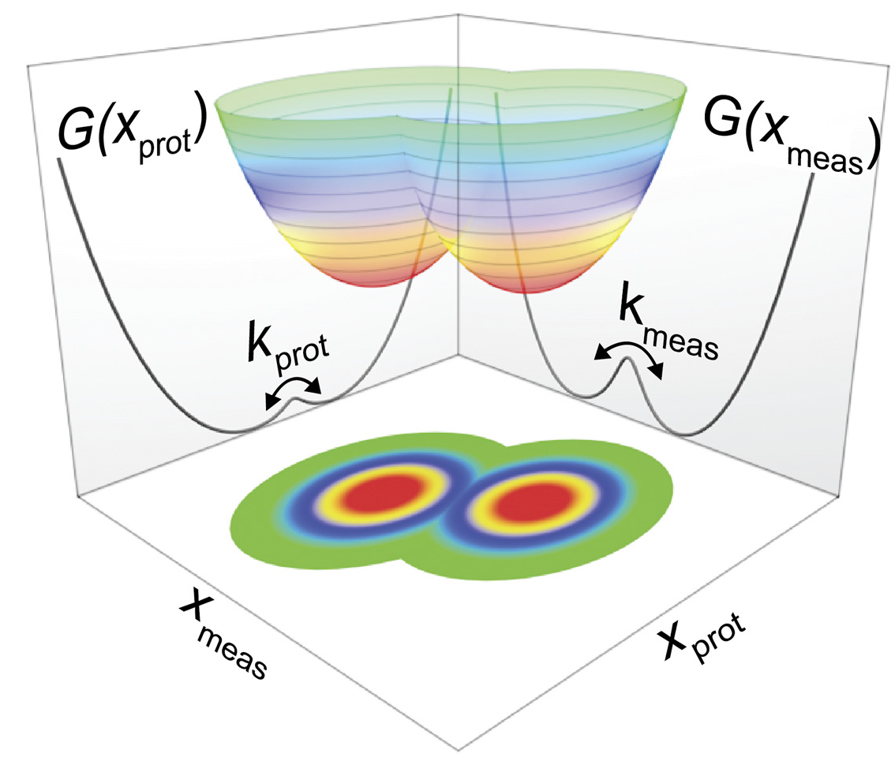
What is optimization?
Minimization of a function given a set of inputs
Applications of numerical optimization
Science/Engineering
Molecular modeling
Control systems
Finance
Portfolio optimization
Econometric models
Policy
Resource allocation
Risk models
Applications of optimization are everywhere
Gilli et al. (2019)
Edwards et al. (2020)

Slide 3
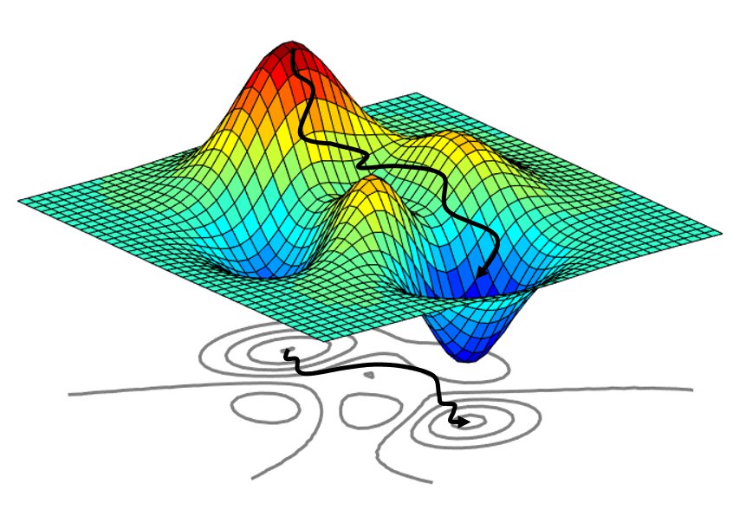
Gradient (steepest) descent
Math

